Slide 1
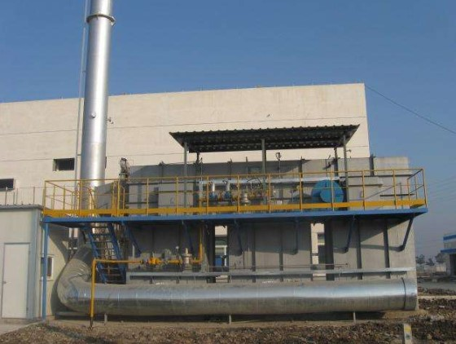
Beijing Oriental Organic Chemical – 20,000 m³/h VOC Treatment
RTO Treatment Process

Slide 2
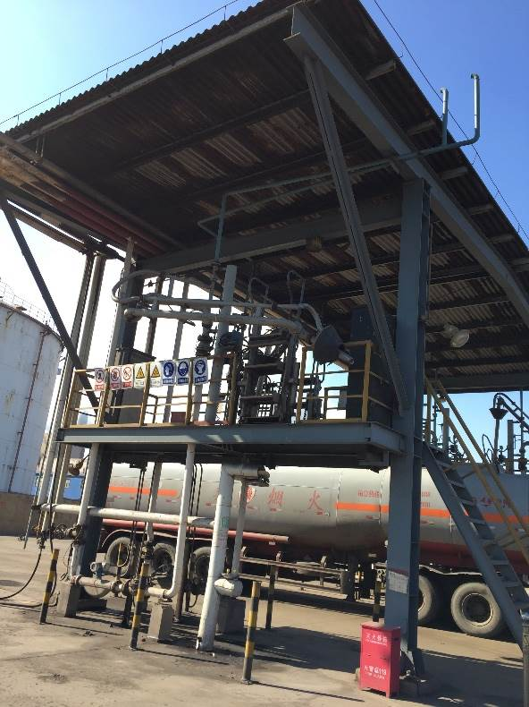
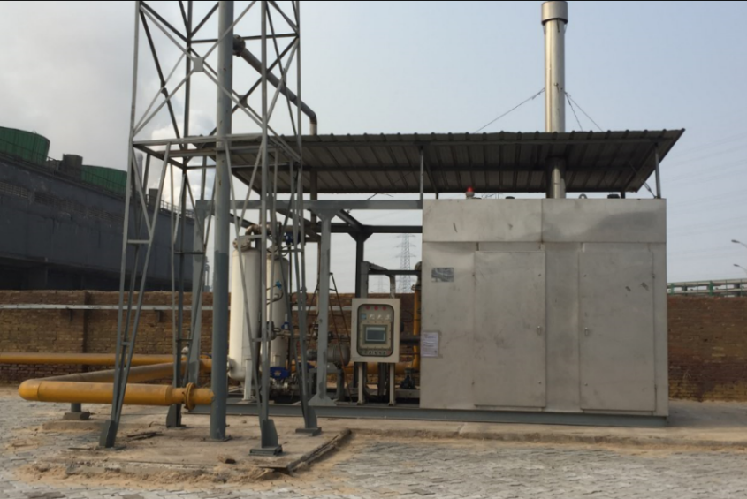
Project Reference – Cangzhou Zhongtie Fuyue Chemical Co., Ltd.
Loading-arm VOC treatment: cryogenic + adsorption
Methanol VOC recovery: 300 m³/h

Slide 3
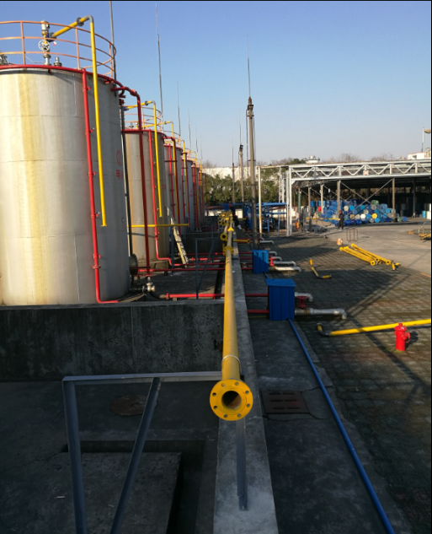
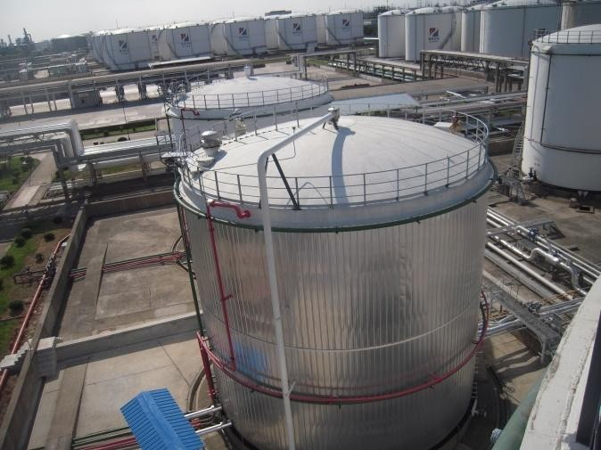
Project Reference – Cangzhou Zhongtie Fuyue Chemical Co., Ltd.
Finished-product tank farm VOC treatment
500 m³/h pressure swing adsorption + absorption

Slide 4
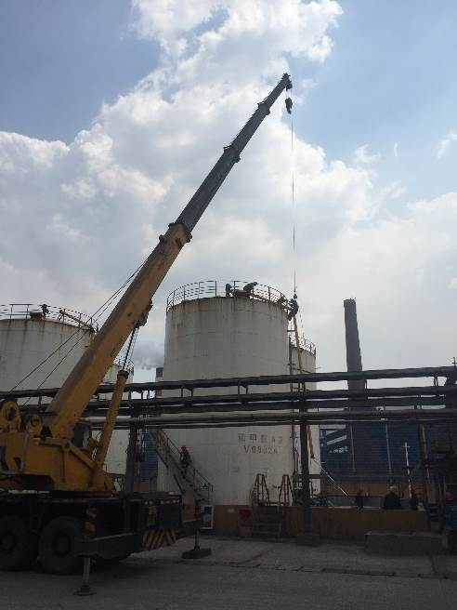
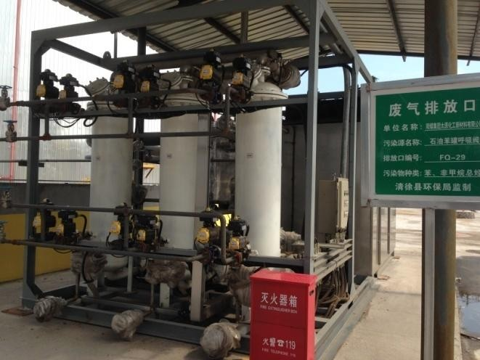
Project Reference – Cangzhou Zhongtie Fuyue Chemical Co., Ltd.
Intermediate tank farm VOC treatment
1,000 m³/h cryogenic + PSA

Slide 5
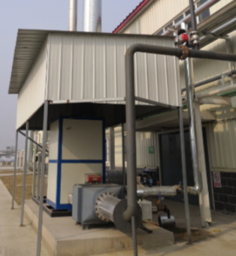
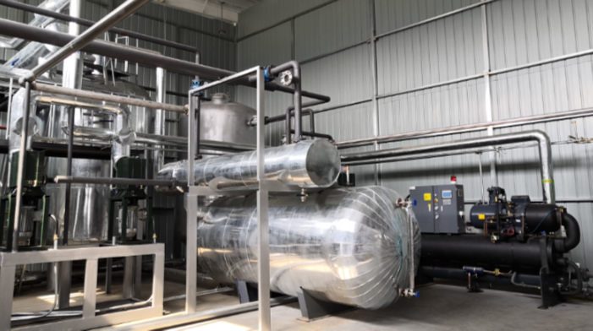
Hebei Meiyesi Phospholipid Technology Co., Ltd. – Acetone Vacuum Pump Tail Gas Treatment
Process: 200 m³/h condensation recovery + 5,000 m³/h catalytic oxidation

Slide 6
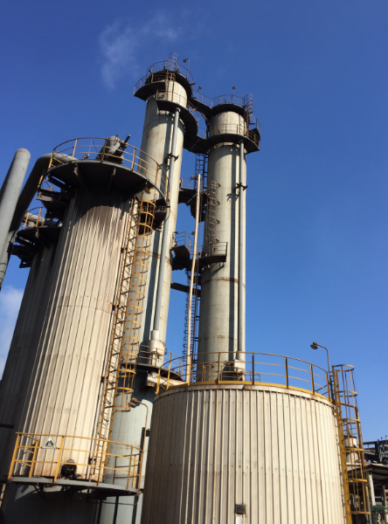
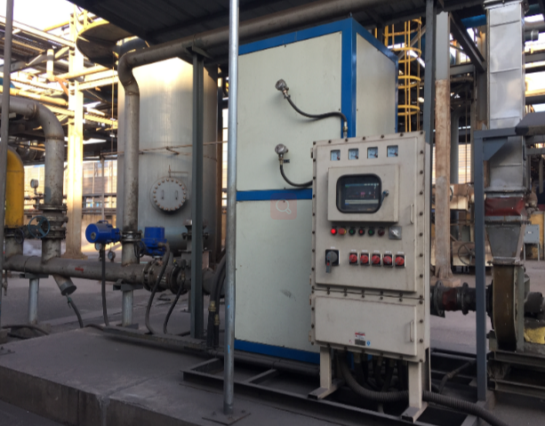
Project Reference – Cangzhou Zhongtie Fuyue Chemical Co., Ltd.
Pre-distillation and desulfurization non-condensable gas
1,000 m³/h catalytic oxidation

Slide 7
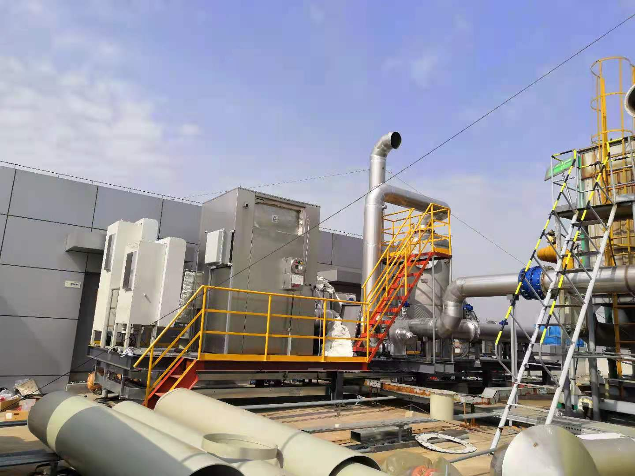
Shijiazhuang Pharmaceutical Group – Zhongnuo
5,000 m³/h tail-gas catalytic oxidation (2 sets)
Shijiazhuang Pharmaceutical Project

Slide 8
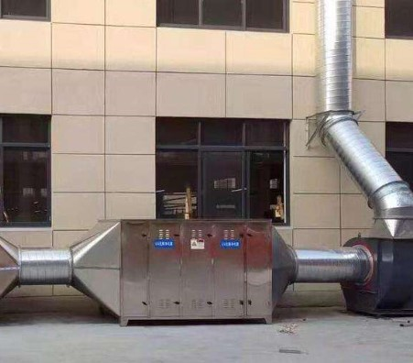
Project Reference – Shijiazhuang Tengfei Printing & Dyeing Co., Ltd.
20,000 m³/h dyeing wastewater odor treatment
alkaline scrubbing + microwave UV oxidation

Slide 9
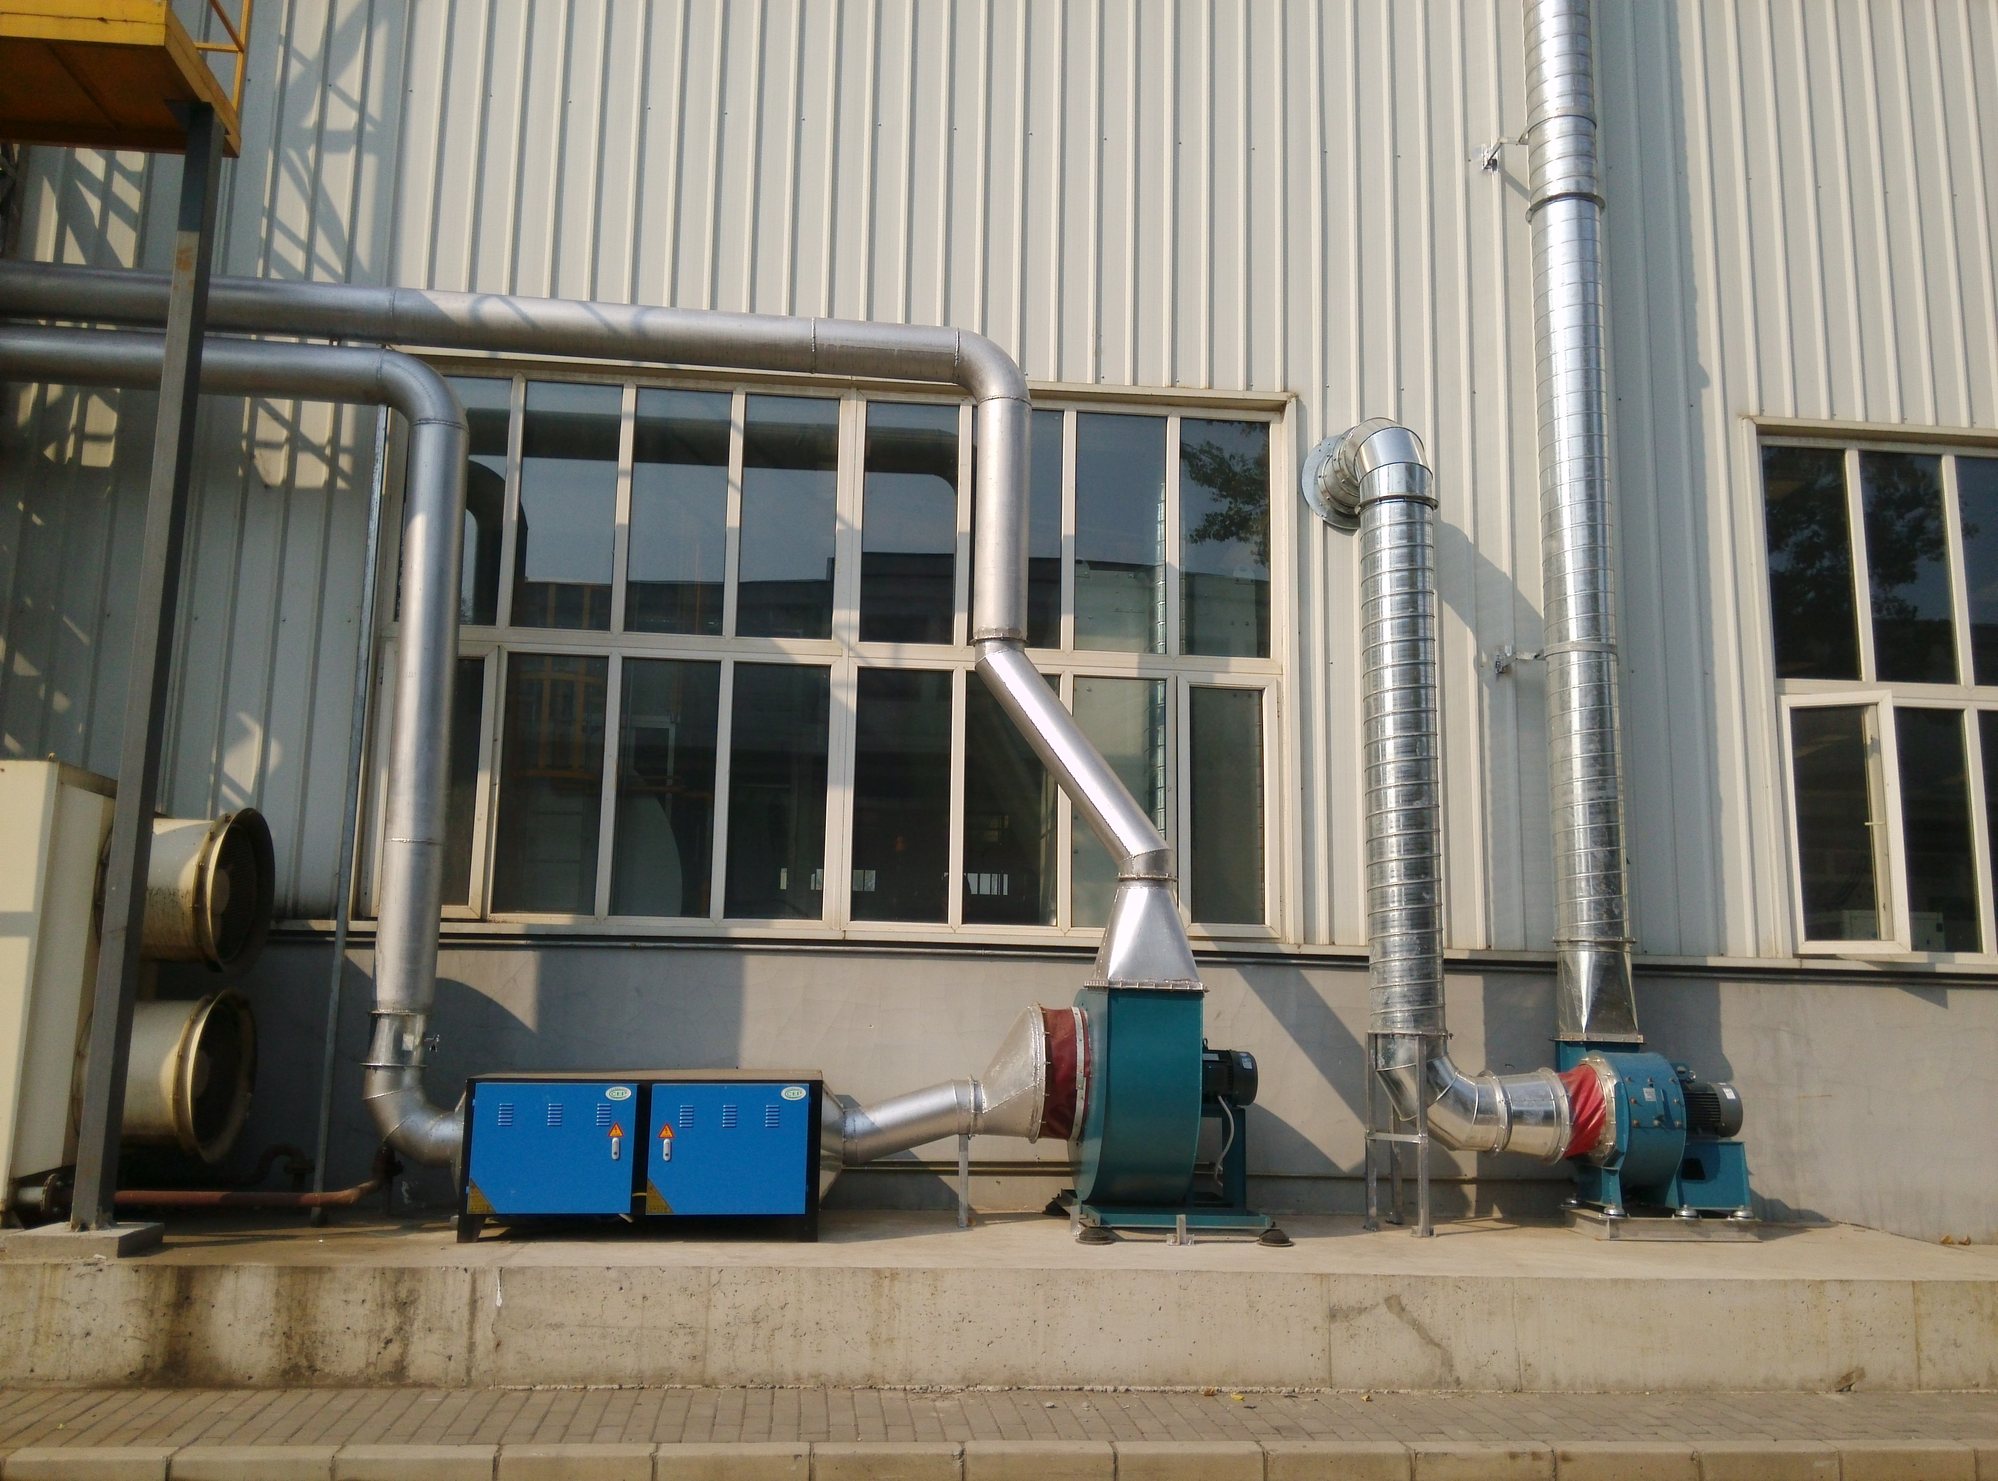
Project Reference – Beijing Vehicle Factory
10,000 m³/h oil-mist purification
high-voltage electrostatic technology

Slide 10
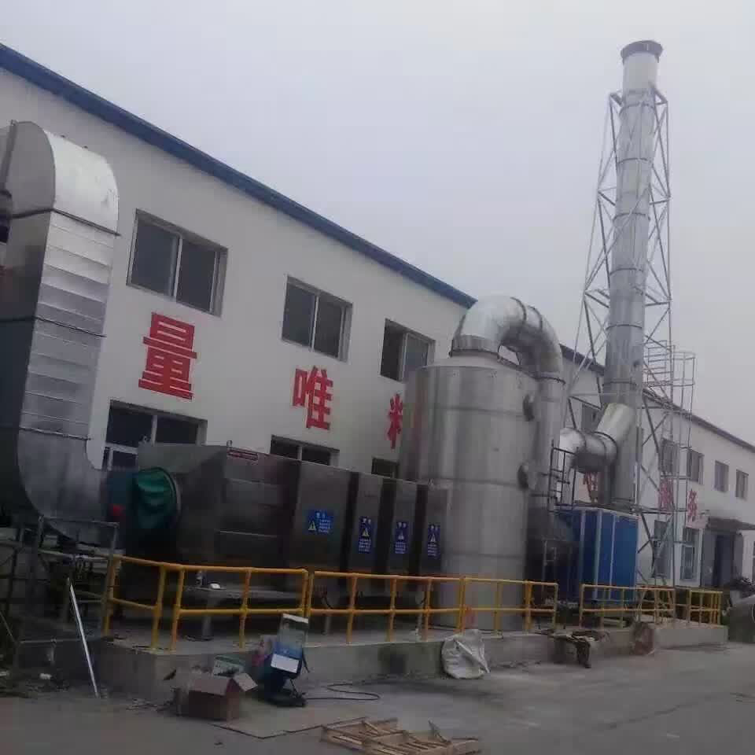
Project Reference – Beijing Vehicle Factory
40,000 m³/h odor treatment
low-temperature plasma technology

Slide 11

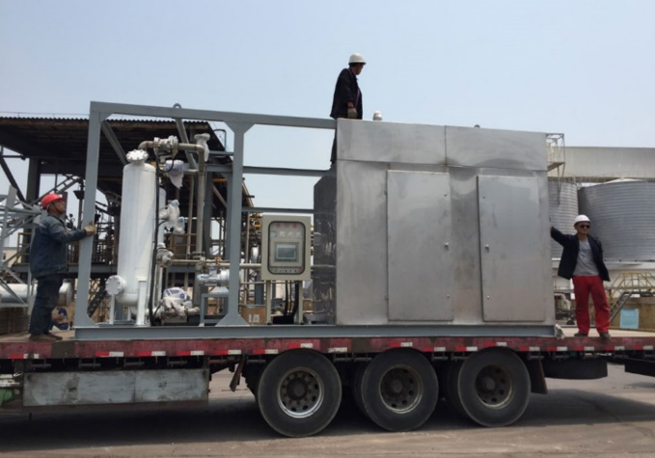
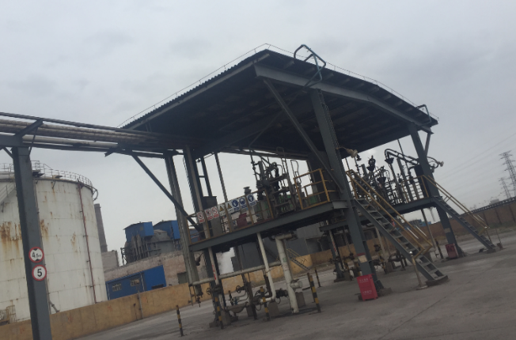
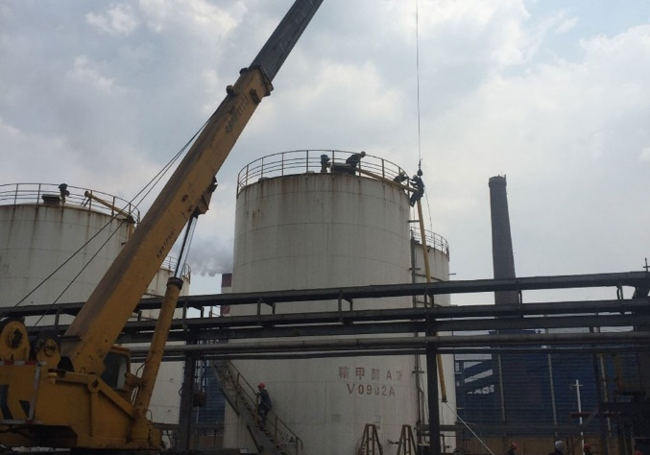
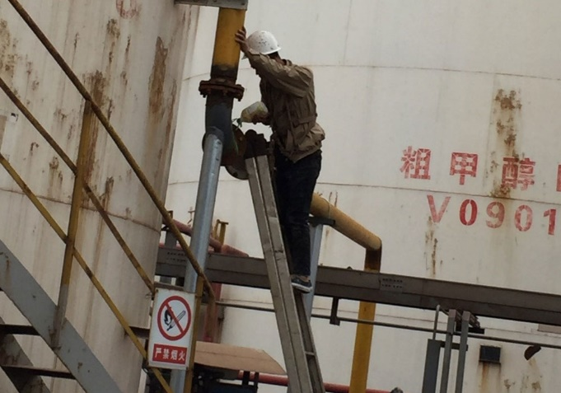
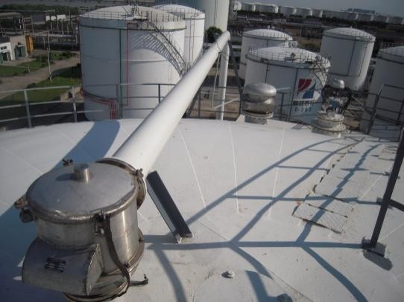
On-site Construction Photos

Slide 12
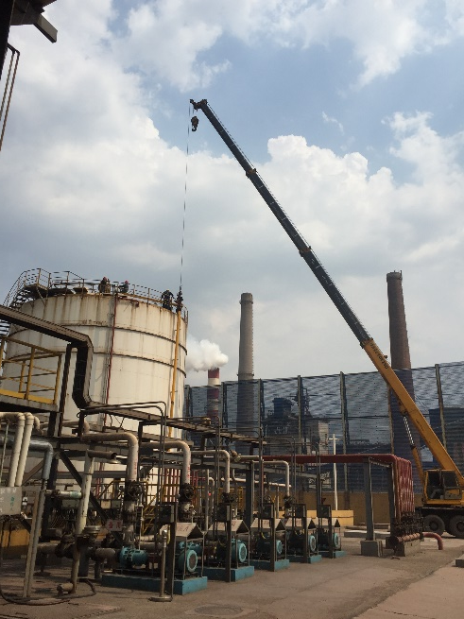
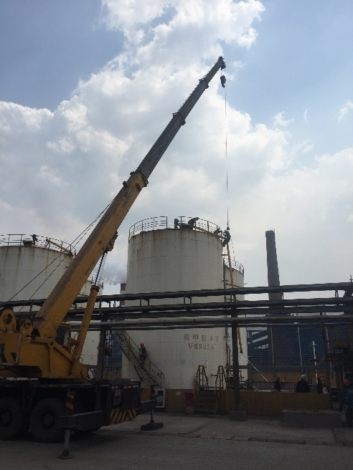
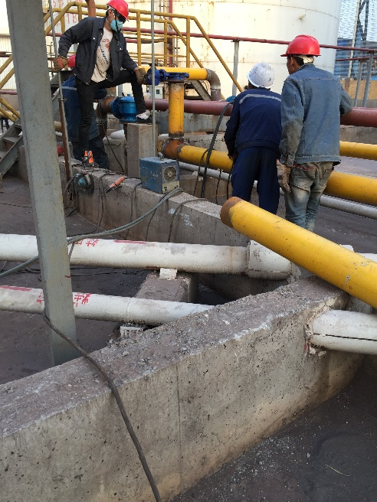
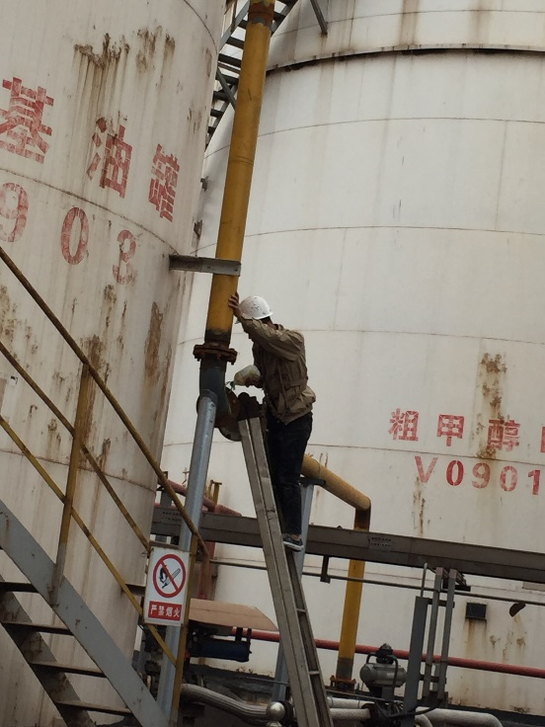
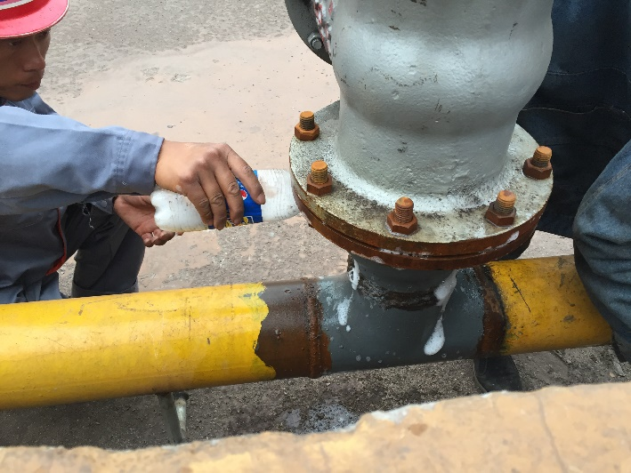
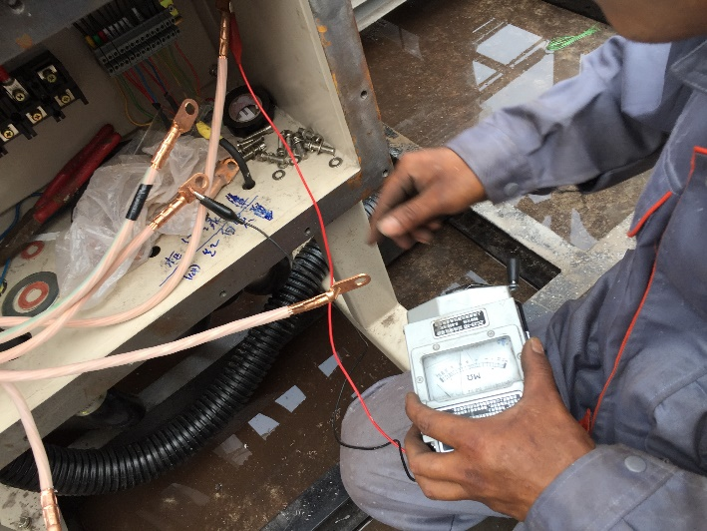
Construction

Slide 13
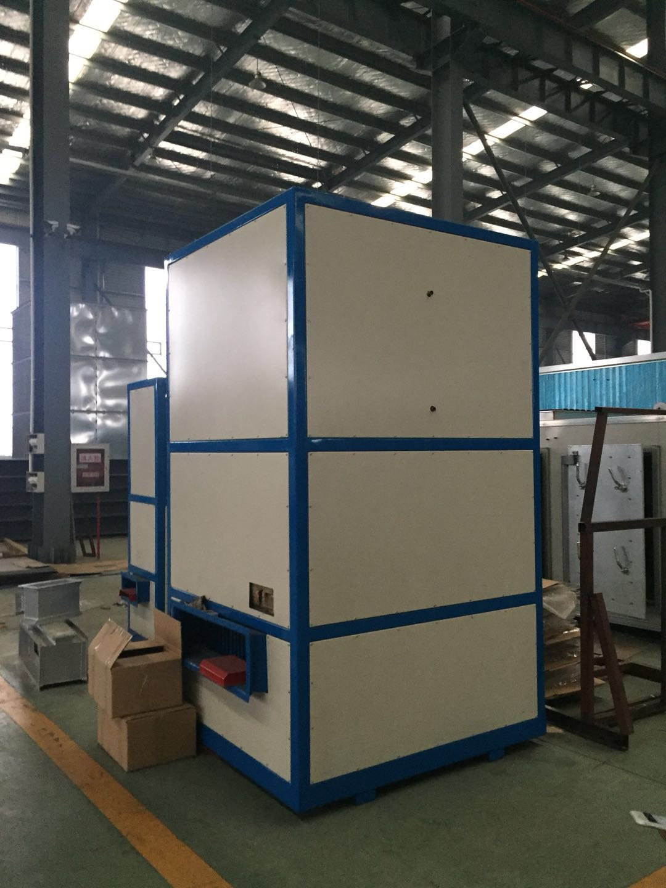
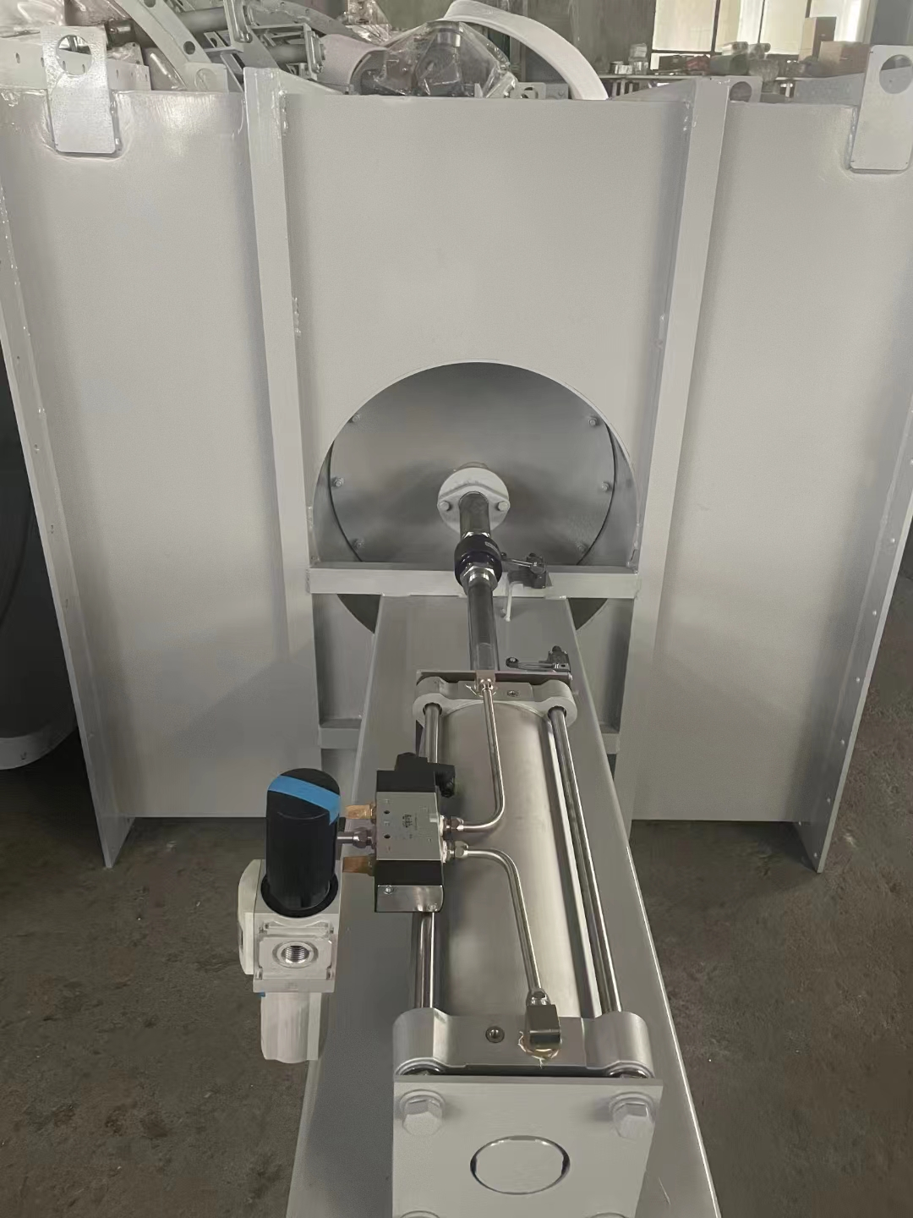
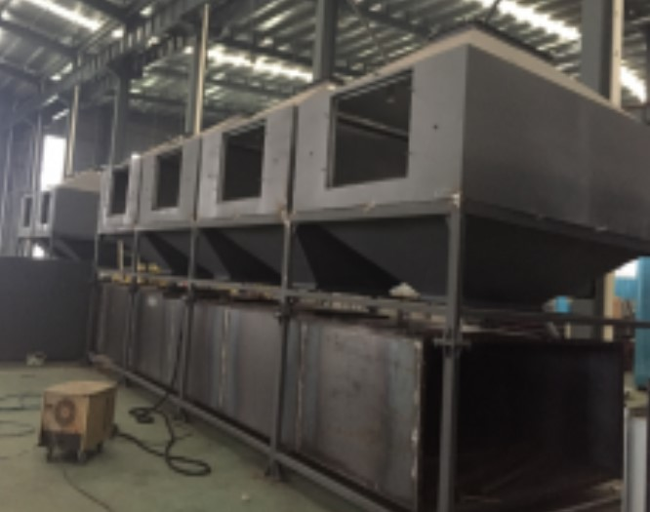
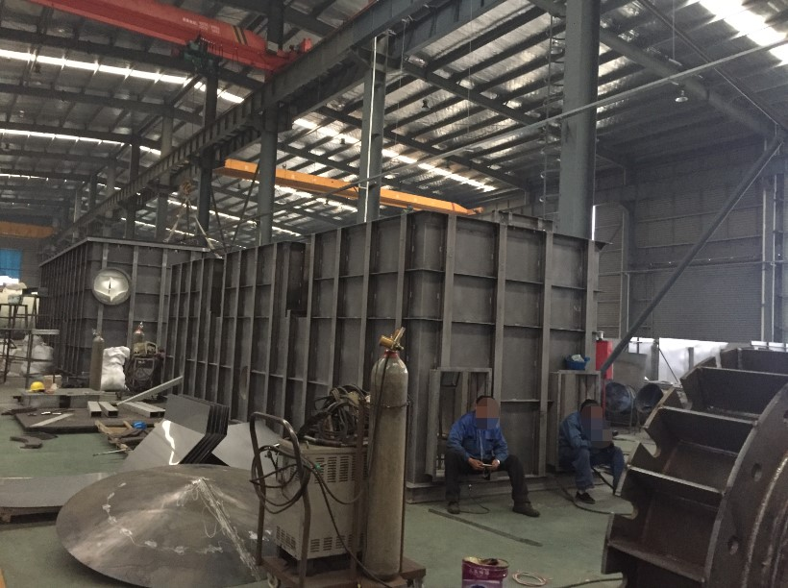
Factory Photos – RTO, CO and TO

Slide 14
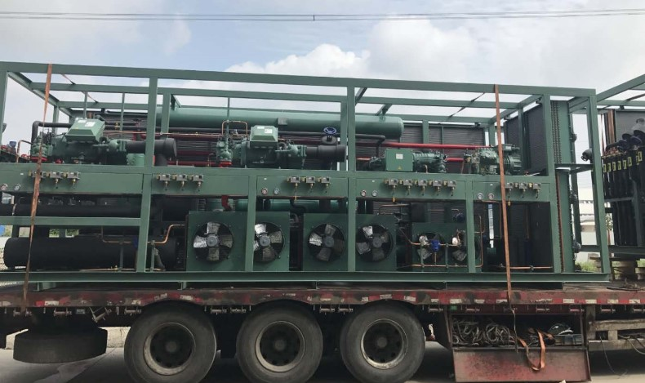
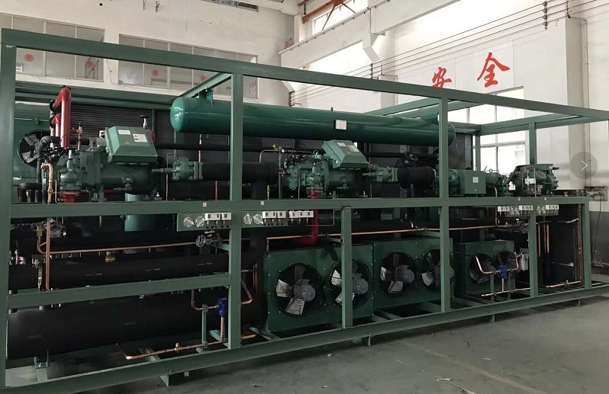
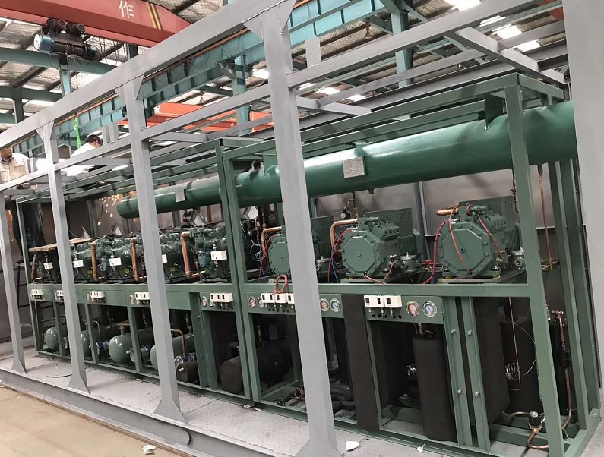
Vapor Recovery Equipment

Slide 15
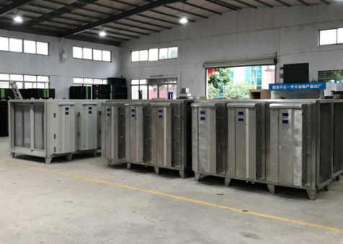
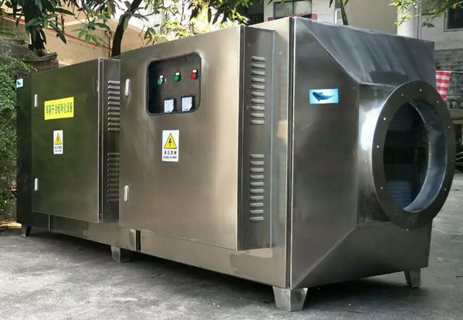
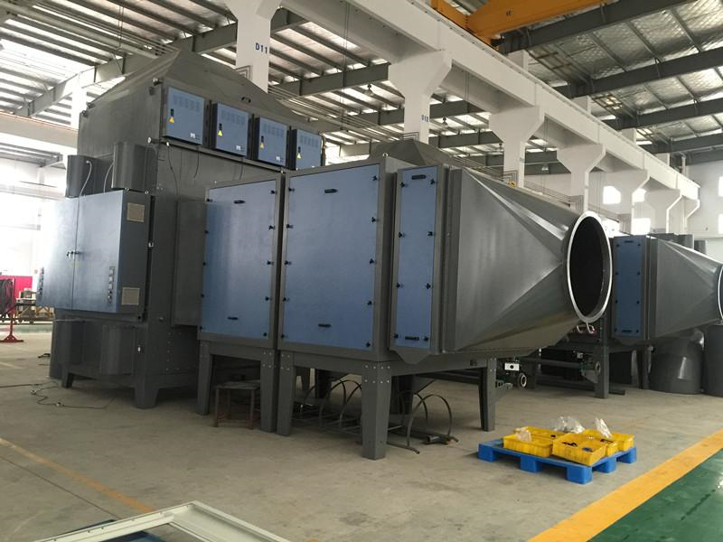
Factory Photos – Plasma & Microwave UV Oxidation

Slide 16

Thank You!
Beijing Gongxiang Environmental Engineering Co., Ltd.
Contact: Sun Wancun
Tel: +86 183 0117 0098
Email: snnn2010@163.com
Website: www.gxhjtc.com
Address: No. 2 Beilong Road, Huilongguan, Changping District, Beijing, China

